Slide 1


International Economics: Theory and Policy
Twelfth Edition
Chapter 3
Labor Productivity and Comparative Advantage: The Ricardian Model
Copyright © 2022, 2018, 2015 Pearson Education, Inc. All Rights Reserved
Notes:
If this PowerPoint presentation contains mathematical equations, you may need to check that your computer has the following installed:
1) MathType Plugin
2) Math Player (free versions available)
3) NVDA Reader (free versions available)

Slide 2
Learning Objectives
3.1 Explain how the Ricardian model, the most basic model of international trade, works and how it illustrates the principle of comparative advantage.
3.2 Demonstrate gains from trade and refute common fallacies about international trade.
3.3 Describe the empirical evidence that wages reflect productivity and that trade patterns reflect relative productivity.

Slide 3
Preview
Opportunity costs and comparative advantage
A one-factor economy, the Ricardian model
Production possibilities
How world relative demand and supply determine the relative price after trade
Gains from trade; relative wages and trade
Misconceptions about comparative advantage
Transportation costs and nontraded goods
Empirical evidence

Slide 4
Introduction
Differences across countries are a key reason why trade occurs:
The Ricardian model (Econ/Trade Chapter 3) examines differences in the productivity of labor (due to differences in technology) between countries.
The Specific Factors model (Econ/Trade Chapter 4) and the Heckscher-Ohlin model (Econ/Trade Chapter 5) examine differences in labor, labor skills, physical capital, land, or other factors of production between countries.
Trade may also arise due to economies of scale (larger scale of production is more efficient).

Slide 5
The Concept of Comparative Advantage (1 of 6)
The opportunity cost of producing something measures the cost of not being able to produce something else with the resources used.
Comparative advantage will be determined by comparing opportunity costs across countries.

Slide 6
The Concept of Comparative Advantage (2 of 6)
A simple example with roses and computers explains the intuition behind the concepts of opportunity cost and comparative advantage in the Ricardian model.
For example, suppose a limited number of workers could produce either roses or computers.
The opportunity cost of producing computers is the amount of roses not produced.
The opportunity cost of producing roses is the amount of computers not produced.

Slide 7
The Concept of Comparative Advantage (3 of 6)
Suppose that in the United States, 10 million roses could be produced with the same resources as 100,000 computers.
Suppose that in Colombia, 10 million roses could be produced with the same resources as 30,000 computers.
Colombia has a lower opportunity cost of producing roses: has to stop producing fewer computers in order to free up resources to make a rose.

Slide 8
The Concept of Comparative Advantage (4 of 6)
A country has a comparative advantage in producing a good if the opportunity cost of producing that good is lower in the country than in other countries.
The United States has a comparative advantage in computer production.
Colombia has a comparative advantage in rose production.

Slide 9
The Concept of Comparative Advantage (5 of 6)
Suppose initially that Colombia produces computers and the United States produces roses, and that both countries want to consume computers and roses.
Can both countries be made better off?

Slide 10
Table 3.1 Hypothetical Changes in Production
Blank | Million Roses | Thousand Computers
United States | negative 10 | +100
Columbia | +10 | negative 30
Total | 0 | +70

Slide 11
The Concept of Comparative Advantage (6 of 6)
When countries specialize in production in which they have a comparative advantage, more goods and services can be produced and consumed.
Have the United States stop growing roses and use those resources to make 100,000 computers instead. Have Colombia stop making 30,000 computers and grow roses instead.
If produce goods in which have a comparative advantage (the United States produces computers and Colombia produces roses), they could still consume the same 10 million roses, but
could consume
more computers.

Slide 12
A One-Factor Economy (1 of 4)
We formalize these ideas by constructing a one-factor Ricardian model using the following assumptions:

Slide 13
A One-Factor Economy (2 of 4)
Labor is the only factor of production.
Labor productivity varies across countries due to differences in technology, but labor productivity in each country is constant.
The supply of labor in each country is constant.
Two goods: wine and cheese.
Competition allows workers to be paid a wage equal to the value of what they produce, and allows them to work in the industry that pays the higher wage.
Two countries: home and foreign.

Slide 14
A One-Factor Economy (3 of 4)
A unit labor requirement indicates the constant number of hours of labor required to produce one unit of output.
is the unit labor requirement for cheese in the home
country.
hours of labor produce one pound of cheese
in the home country.
is the unit labor requirement for wine in the home
country.
hours of labor produce one gallon of wine
in the home country.
A high unit labor requirement means low labor productivity.
Labor productivity is how much output one hour of labor creates.

Slide 15
A One-Factor Economy (4 of 4)
Labor supply L indicates the total amount of labor resources—the number of hours worked (a constant parameter).
indicates the amount of labor required for each pound of
cheese produced (a constant).
Cheese production
indicates how many total pounds of cheese
that the home country produces.
indicates the amount of labor required for each gallon of wine
produced (a constant).
Wine production
indicates how many total gallons of
wine that the home country produces.

Slide 16
Production Possibilities (1 of 6)
The production possibility frontier (P P F) of an economy shows the maximum amount of a goods that can be produced for a fixed amount of resources.
The PPF of the home economy is

Slide 17
Production Possibilities (2 of 6)
Maximum home cheese production is
Maximum home wine production is

Slide 18
Production Possibilities (3 of 6)
For example, suppose that the home economy’s labor supply is 1,000 hours.
so one hour of labor produces one pound of
cheese in the home country.
so two hours of labor produces one
gallon of wine in the home country.
The P P F equation
Maximum cheese production is 1,000 pounds.
Maximum wine production is 500 gallons.

Slide 19
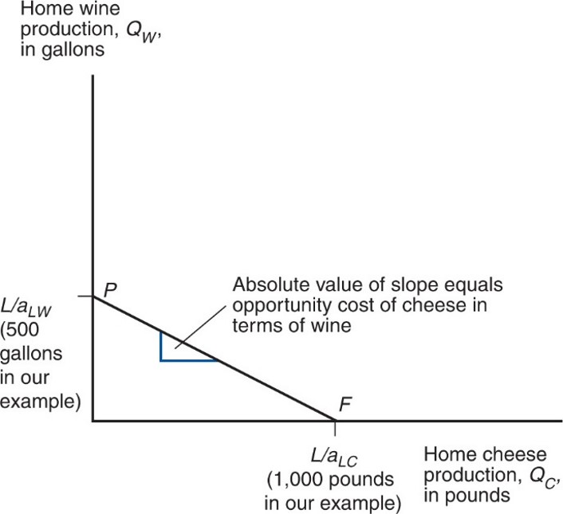
Figure 3.1 Home’s Production Possibility Frontier
The line P F shows the maximum amount of cheese Home can produce given any production of wine, and vice versa.
Notes:
The line, P F, shows the maximum amount of cheese, home can produce given any production of wine, and vice versa. This line falls from point P on the y-axis at ratio L over a, sub L W, 500 gallons in the example, to point F on the x-axis, ration L over a sub L C, 1,000 pounds. The absolute value of the slope equals the opportunity cost of cheese in terms of wine.

Slide 20
Production Possibilities (4 of 6)
The opportunity cost of cheese is how many gallons of wine Home must stop producing in order to make one more pound of cheese:
The opportunity cost is constant because the unit labor requirements are both constant.
The opportunity cost of cheese appears as the absolute value of the slope of the P P F.

Slide 21
Production Possibilities (5 of 6)
Producing an additional pound of cheese requires
hours of labor.
Each hour devoted to cheese production could have been used instead to produce an amount of wine equal to
Notes:
Start fraction 1 hour over left parenthesis a sub start expression L W end expression hours per gallon of wine right parenthesis end fraction = left parenthesis start fraction 1 over a sub start expression L W end expression end fraction right parenthesis gallons of wine

Slide 22
Production Possibilities (6 of 6)
For example, if one hour of labor is moved to cheese production, that additional hour could have produced
Opportunity cost of producing one pound of cheese is
gallon of wine not produced.

Slide 23
Relative Prices and Supply (1 of 7)
is the price of cheese;
is the price of wine.
is the wage paid to workers who make cheese, and
is the wage paid to workers who make wine.
Due to competition in the labor and goods markets:
Hourly wages of cheese makers will equal the value of the cheese produced in an hour:
Hourly wages of wine makers will equal the value of the wine produced in an hour:

Slide 24
Relative Prices and Supply (2 of 7)
Workers will choose to work in the industry that pays the higher wage.
If the price of cheese relative to the price of wine exceeds the opportunity cost of producing cheese
Then the wage paid when making cheese will exceed the wage in wine
So workers will make only cheese (the economy specializes in cheese production).

Slide 25
Relative Prices and Supply (3 of 7)
If the price of cheese relative to the price of wine is less than the opportunity cost of producing cheese
Then the wage in cheese will be less than the wage in wine
So workers will make only wine (the economy specializes in wine production).

Slide 26
Relative Prices and Supply (4 of 7)
If the price of cheese relative to the price of wine equals the opportunity cost of producing cheese
Then the wage in cheese will equal the wage in wine
So workers will be willing to make both wine and cheese.

Slide 27
Relative Prices and Supply (5 of 7)
For example, suppose cheese sells for
and wine sells for
Wage paid producing cheese is
Wage paid producing wine is
Workers would be willing to make only cheese (the relative price
of cheese
exceeds the opportunity cost of cheese

Slide 28
Relative Prices and Supply (6 of 7)
If the price of cheese drops to
Wage paid producing cheese drops to
Wage paid producing wine is still
if price of
wine is still
Now workers would be willing to make only wine (the relative
price of cheese
is now less than the opportunity cost of
cheese

Slide 29
Relative Prices and Supply (7 of 7)
If the home country wants to consume both wine and cheese (in the absence of international trade), relative prices must adjust so that wages are equal in the wine and cheese industries.
If
workers will not care whether they work in the
cheese industry or the wine industry, so that production of both goods can occur.
Production (and consumption) of both goods occurs when the relative price of a good equals the opportunity cost of producing that good:

Slide 30
Trade in the Ricardian Model (1 of 4)
to indicate foreign country variables.
When one country can produce a unit of a good with less labor than another country, we say that the first country has an absolute advantage in producing that good.
If
Home labor is more efficient than Foreign in
producing cheese.
Does that guarantee that Home should export cheese?

Slide 31
Trade in the Ricardian Model (2 of 4)
Comparative advantage, not absolute advantage, determines the pattern of trade (more about this distinction later).
Suppose that the home country has a comparative advantage in cheese production: its opportunity cost of producing cheese is lower than the foreign country.
When the home country increases cheese production, it reduces wine production less than the foreign country would.
Notes:
Start fraction a sub start expression L C end expression over a sub start expression L W end expression end fraction is less than start fraction a to the asterisk power sub start expression L C end expression over a to the asterisk power sub start expression L W end expression end fraction

Slide 32
Trade in the Ricardian Model (3 of 4)
Since the slope of the P P F indicates the opportunity cost of cheese in terms of wine, Foreign’s P P F is steeper than Home’s.
To produce one pound of cheese, must stop producing more gallons of wine in Foreign than in Home.

Slide 33
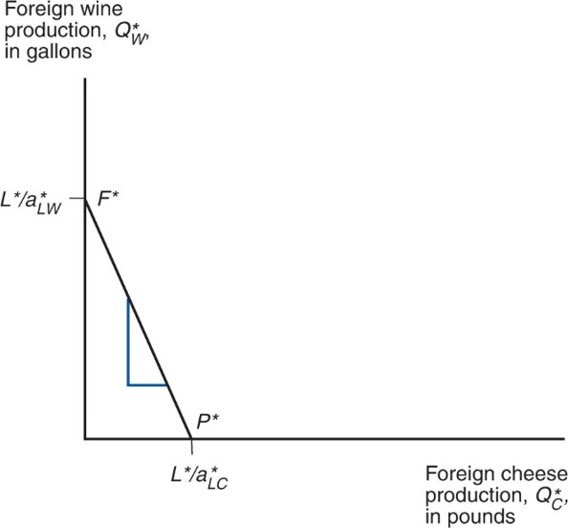
Figure 3.2 Foreign’s Production Possibility Frontier
Because Foreign’s relative unit labor requirement in cheese is higher than Home’s (it needs to give up many more units of wine to produce one more unit of cheese), its production possibility frontier is steeper.
Notes:
The line F asterisk P asterisk falls steeply from the ratio L asterisk over, ay asterisk, sub L W on the y-axis to point L asterisk over, ay asterisk, sub L C on the x-axis.

Slide 34
Trade in the Ricardian Model (4 of 4)
Before any trade occurs, the relative price of cheese to wine reflects the opportunity cost of cheese in terms of wine in each country.
In the absence of any trade, the relative price of cheese to wine will be higher in Foreign than in Home if Foreign has the higher opportunity cost of cheese.
It will be profitable to ship cheese from Home to Foreign (and wine from Foreign to Home)—where does the relative price of cheese to wine settle?

Slide 35
Determining the Relative Price after Trade (1 of 8)
To see how all countries can benefit from trade, need to find relative prices when trade exists.
First calculate the world relative supply of cheese: the quantity of cheese supplied by all countries relative to the quantity of wine supplied by all countries:

Slide 36
Determining the Relative Price after Trade (2 of 8)
If the relative price of cheese falls below the opportunity cost of cheese in both countries
No cheese would be produced.
Domestic and foreign workers would be willing to produce only wine (where wage is higher).
Notes:
Start fraction P sub C over P sub W end fraction is less than a sub start expression L C end expression over a sub start expression L W end expression end fraction is less than start fraction a to the asterisk power sub start expression L C end expression over a to the asterisk power sub start expression L W end expression end fraction,

Slide 37
Determining the Relative Price after Trade (3 of 8)
When the relative price of cheese equals the opportunity cost in the home country
Domestic workers are indifferent about producing wine or cheese (wage when producing wine same as wage when producing cheese).
Foreign workers produce only wine.
Notes:
Start fraction P sub C over P sub W end fraction = a sub start expression L C end expression over a sub start expression L W end expression end fraction is less than start fraction a to the asterisk power sub start expression L C end expression over a to the asterisk power sub start expression L W end expression end fraction,

Slide 38
Determining the Relative Price after Trade (4 of 8)
When the relative price of cheese settles strictly in between the opportunity costs of cheese
Domestic workers produce only cheese (where their wages are higher).
Foreign workers still produce only wine (where their wages are higher).
World relative supply of cheese equals Home’s maximum cheese production divided by Foreign’s maximum wine production
Notes:
Start fraction a sub start expression L C end expression over a sub start expression L W end expression end fraction is less than Start fraction P sub C over P sub W end fraction is less than start fraction a to the asterisk power sub start expression L C end expression over a to the asterisk power sub start expression L W end expression end fraction,

Slide 39
Determining the Relative Price after Trade (5 of 8)
When the relative price of cheese equals the opportunity cost in the foreign country
Foreign workers are indifferent about producing wine or cheese (wage when producing wine same as wage when producing cheese).
Domestic workers produce only cheese.
Notes:
Start fraction a sub start expression L C end expression over a sub start expression L W end expression end fraction is less than Start fraction P sub C over P sub W end fraction = start fraction a to the asterisk power sub start expression L C end expression over a to the asterisk power sub start expression L W end expression end fraction,

Slide 40
Determining the Relative Price after Trade (6 of 8)
If the relative price of cheese rises above the opportunity cost of cheese in both countries
No wine is produced.
Domestic and foreign workers are willing to produce only cheese (where wage is higher).
Notes:
Start fraction a sub start expression L C end expression over a sub start expression L W end expression end fraction is less than start fraction a to the asterisk power sub start expression L C end expression over a to the asterisk power sub start expression L W end expression end fraction is less than Start fraction P sub C over P sub W end fraction,

Slide 41
Determining the Relative Price after Trade (7 of 8)
World relative supply is a step function:
First step at relative price of cheese equal to Home’s
opportunity cost
in the example.
Jumps when world relative supply of cheese equals Home’s maximum cheese production divided by Foreign’s
maximum wine production
which equals 1 in the
example.
Second step at relative price of cheese equal to Foreign’s
opportunity cost
which equals 2 in the example.

Slide 42
Determining the Relative Price after Trade (8 of 8)
Relative demand of cheese is the quantity of cheese demanded in all countries relative to the quantity of wine demanded in all countries.
As the price of cheese relative to the price of wine rises, consumers in all countries will tend to purchase less cheese and more wine so that the relative quantity demanded of cheese falls.

Slide 43
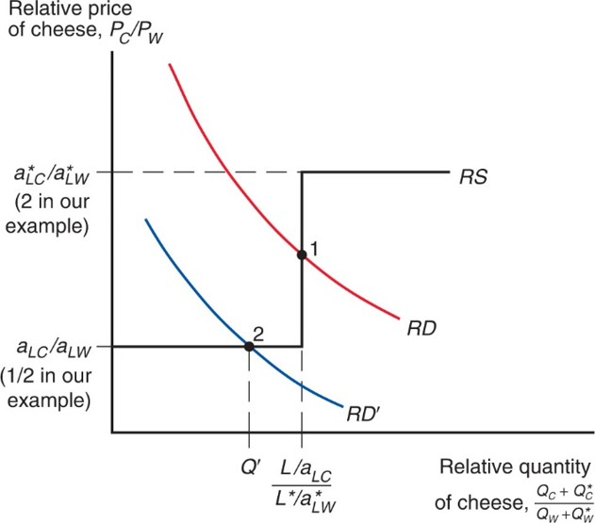
Figure 3.3 World Relative Supply and Demand
The R D and R D′ curves show that the demand for cheese relative to wine is a decreasing function of the price of cheese relative to that of wine, while the R S curve shows that the supply of cheese relative to wine is an increasing function of the same relative price.
Notes:
The R S curve extends horizontally from the ratio ay sub L C over, ay sub L W on the y-axis, which is one-half in the example. It then rises vertically from the x-value, ratio L over ay, sub L C over, L asterisk over, ay asterisk, sub L W to the y-value, ay asterisk, sub L C over ay asterisk, sub L W. The R S curve then continues horizontally to the right at ay asterisk sub L C over ay asterisk sub L W, which is 2 in the example. The plots for R D and R D prime are parallel and fall with decreasing steepness; R D is higher than R D prime. R D crosses the R S graph at point 1, the ratio L over ay, sub L C over, L asterisk over, ay asterisk, sub L W on the x-axis; point 1 is roughly midway between ay asterisk sub L C, over ay asterisk, sub L W, and ay sub L C over ay sub L W. R D prime crosses the R S graph at point 2, where x = Q prime, to the left of point 1, and where y = ay sub L C over ay sub L W on the y-axis.

Slide 44
The Gains from Trade (1 of 4)
Gains from trade come from specializing in the type of production that uses resources most efficiently, and using the income generated from that production to buy the goods and services that countries desire.
“Using resources most efficiently” means producing a good in which a country has a comparative advantage.

Slide 45
The Gains from Trade (2 of 4)
Domestic workers earn a higher income from cheese production because the relative price of cheese increases with trade.
Foreign workers earn a higher income from wine production because the relative price of cheese decreases with trade (making cheese cheaper), and the relative price of wine increases with trade.

Slide 46
The Gains from Trade (3 of 4)
Think of trade as an indirect method of production that converts cheese into wine or vice versa.
Without trade, a country has to allocate resources to produce all of the goods that it wants to consume.
With trade, a country can specialize its production and exchange for the mix of goods that it wants to consume.

Slide 47
The Gains from Trade (4 of 4)
Consumption possibilities expand beyond the production possibility frontier when trade is allowed.
With trade, consumption in each country is expanded because world production is expanded when each country specializes in producing the good in which it has a comparative advantage.

Slide 48
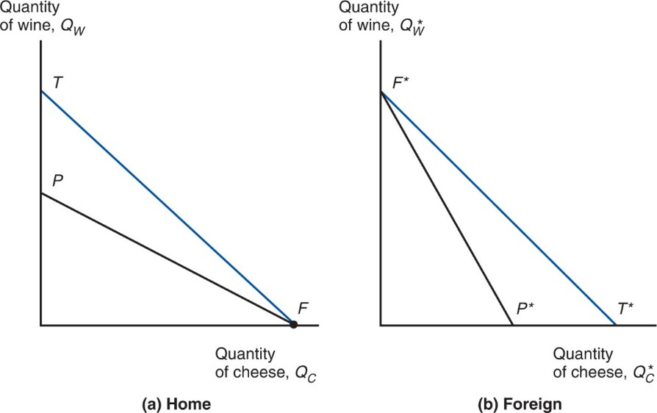
Figure 3.4 Trade Expands Consumption Possibilities
International trade allows Home and Foreign to consume anywhere within the outer lines, which lie outside the countries’ production frontiers.
Notes:
A falling line P F, beginning at P on the y-axis, ends at point F on the x-axis. A second line, T F, begins above point P on the y-axis at point T, and falls more steeply than P F to point F on the x-axis. The second graph, b, foreign, plots the quantity of wine, Q asterisk, sub W on the y-axis versus quantity of cheese, Q asterisk, sub C on the x-axis. Two falling lines begin at point F asterisk on the y-axis. Line F asterisk P asterisk falls more steeply than line F asterisk T asterisk, with T asterisk to the right of P asterisk on the x-axis.

Slide 49
A Numerical Example (1 of 5)
Unit labor requirements | Cheese | Wine
Home | a sub start expression L C end expression = 1 hour per pound | a sub start expression L W end expression = 2 hours per gallon
Foreign | a to the asterisk power sub start expression L C end expression = 6 hours per pound | a to the asterisk power sub start expression L W end expression = 3 hours per gallon
What is the home country’s opportunity cost of producing
cheese?
to produce one pound of
cheese, stop producing

Slide 50
A Numerical Example (2 of 5)
The home country is more efficient in both industries, but has a comparative advantage only in cheese production.
The foreign country is less efficient in both industries, but has a comparative advantage in wine production.
Notes:
1 half = Start fraction a sub start expression L C end expression over a sub start expression L W end expression end fraction is less than start fraction a to the asterisk power sub start expression L C end expression over a to the asterisk power sub start expression L W end expression end fraction = 2

Slide 51
A Numerical Example (3 of 5)
With trade, the equilibrium relative price of cheese to wine settles between the two opportunity costs of cheese.
Suppose the intersection of R S and R D occurs at
so one pound of cheese trades for one gallon of
wine.
Trade causes the relative price of cheese to rise in the home country and fall in foreign.

Slide 52
A Numerical Example (4 of 5)
With trade, the foreign country can buy one pound of cheese for
instead of stopping production of
of wine to free up enough labor to produce one pound of cheese in the absence of trade.
Suppose
The foreign country can trade its 1,000
gallons maximum production of wine for 1,000 pounds of cheese, instead of the 500 pounds of cheese it could produce itself.

Slide 53
A Numerical Example (5 of 5)
With trade, the home country can buy one gallon of wine for
instead of stopping production of
of cheese to free up enough labor to produce one gallon of wine in the absence of trade.
The home country can trade its 1,000 pounds maximum production of cheese for 1,000 gallons of wine, instead of the 500 gallons of wine it could produce itself.

Slide 54
Relative Wages (1 of 5)
Relative wages are the wages of the home country relative to the wages in the foreign country.
Productivity (technological) differences determine relative wage differences across countries.
The home wage relative to the foreign wage will settle in between the ratio of how much better Home is at making cheese, and how much better it is at making wine compared to Foreign.
Relative wages cause Home to have a cost advantage in only cheese, and Foreign to have a cost advantage in only wine.

Slide 55
Relative Wages (2 of 5)
Suppose that
Since domestic workers specialize in cheese production after trade, their hourly wages will be
Since foreign workers specialize in wine production after trade, their hourly wages will be
The relative wage of domestic workers is therefore

Slide 56
Relative Wages (3 of 5)
The relative wage lies between the ratio of the productivities in each industry.
The home country is
times as productive in
cheese production, but only
times as
productive in wine production.
The home country has a wage three times higher than the foreign country.

Slide 57
Relative Wages (4 of 5)
These relationships imply that both countries have a cost advantage in production.
High wages can be offset by high productivity.
Low productivity can be offset by low wages.
In the home economy, producing one pound of cheese costs
but would have cost
in Foreign.
In the foreign economy, producing one gallon of wine costs
but would have cost $24
in Home.

Slide 58
Relative Wages (5 of 5)
Because foreign workers have a wage that is only
the wage of domestic workers, they are able to attain a cost advantage in wine production, despite low productivity.
Because domestic workers have a productivity that is six times that of foreign workers in cheese production, they are able to attain a cost advantage in cheese production, despite high wages.

Slide 59
Do Wages Reflect Productivity? (1 of 2)
Do relative wages reflect relative productivities of the two countries?
Evidence shows that low wages are associated with low productivity.
Wage of most countries relative to the United States is similar to their productivity relative to the United States.

Slide 60
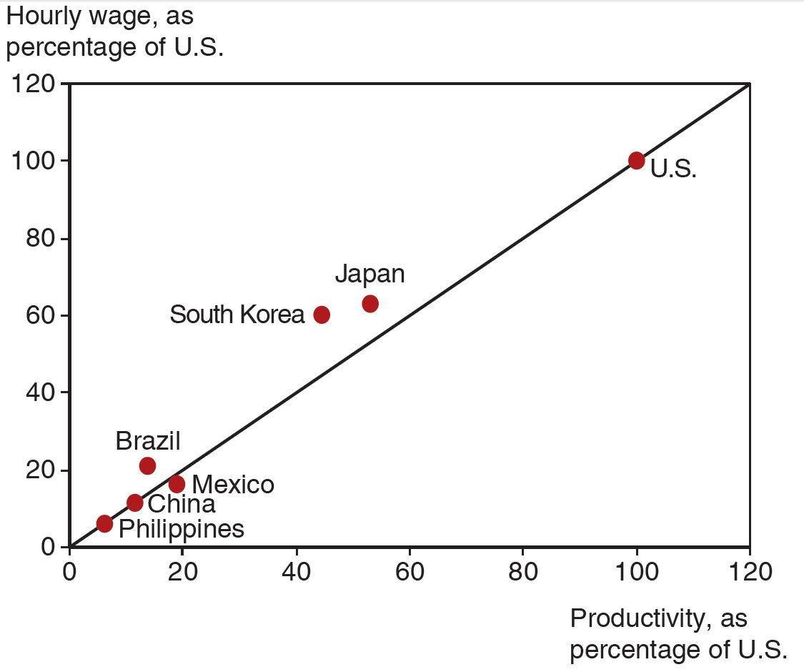
Productivity and Wages
A country’s wage rate is roughly proportional to the country’s productivity
Source: International Monetary Fund and The Conference Board.
Notes:
A line of best fit rises from (0, 0) through (120, 120). The Philippines, China, Mexico, and Brazil are clustered below point (20, 20). Korea and Japan are near the mid-point of the line, at approximately (50, 60). The U S is plotted on the line at (100, 100). All values estimated.

Slide 61
Do Wages Reflect Productivity? (2 of 2)
Other evidence shows that wages rise as productivity rises.
As recently as 1975, wages in South Korea were only 5 percent of those of the United States.
As South Korea’s labor productivity rose (to about half of the U.S. level by 2007), so did its wages.

Slide 62
Misconceptions about Comparative Advantage (1 of 3)
Free trade is beneficial only if a country is more productive than foreign countries.
But even an unproductive country benefits from free trade by avoiding the high costs for goods that it would otherwise have to produce domestically.
High costs derive from inefficient use of resources.
The benefits of free trade do not depend on absolute advantage, rather they depend on comparative advantage: specializing in industries that use resources most efficiently.

Slide 63
Misconceptions about Comparative Advantage (2 of 3)
Free trade with countries that pay low wages hurts high-wage countries.
While trade may reduce wages for some workers, thereby affecting the distribution of income within a country, trade benefits consumers and other workers.
Consumers benefit because they can purchase goods more cheaply.
Producers/workers benefit by earning a higher income in the industries that use resources more efficiently, allowing them to earn higher prices and wages.

Slide 64
Misconceptions about Comparative Advantage (3 of 3)
Free trade exploits less productive countries whose workers make low wages.
While labor standards in some countries are less than exemplary compared to Western standards, they are so with or without trade.
Are high wages and safe labor practices alternatives to trade? Deeper poverty and exploitation may result without export production.
Consumers benefit from free trade by having access to cheaply (efficiently) produced goods.
Producers/workers benefit from having higher profits/wages—higher compared to the alternative.

Slide 65
Comparative Advantage with Many Goods (1 of 7)
Suppose now there are N goods produced, indexed by
The home country’s unit labor requirement for good i is
and the corresponding foreign unit labor requirement is
Goods will be produced wherever cheapest to produce them.

Slide 66
Comparative Advantage with Many Goods (2 of 7)
Let w represent the wage rate in the home country, and
represent the wage rate in the foreign country.
If
then only the home country will produce good
1, since total wage payments are less there.
Or equivalently,
if the relative productivity
of a country in producing a good is higher than the relative wage, then the good will be produced in that country.

Slide 67
Table 3.2 Home and Foreign Unit Labor Requirements
Good | Home Unit Labor Requirement a sub start expression L i end expression | Foreign Unit Labor Requirement a sub start expression L i end expression to the asterisk power | Relative Home Productivity Advantage Start fraction a sub start expression L i end expression to the asterisk power over a sub start expression L i end expression end fraction
Apples | 1 | 10 | 10
Bananas | 5 | 40 | 8
Caviar | 3 | 12 | 4
Dates | 6 | 12 | 2
Enchiladas | 12 | 9 | 0.75

Slide 68
Comparative Advantage with Many Goods (3 of 7)
Suppose there are five goods produced in the world: apples, bananas, caviar, dates, and enchiladas.
If
the home country will produce apples,
bananas, and caviar, while the foreign country will produce dates and enchiladas.
The relative productivities of the home country in producing apples, bananas, and caviar are higher than the relative wage.

Slide 69
Comparative Advantage with Many Goods (4 of 7)
If each country specializes in goods that use resources productively and trades the products for those that it wants to consume, then each benefits.
If a country tries to produce all goods for itself, resources are “wasted.”
The home country has high productivity in apples, bananas, and caviar that give it a cost advantage, despite its high wage.
The foreign country has low wages that give it a cost advantage, despite its low productivity in date production.

Slide 70
Comparative Advantage with Many Goods (5 of 7)
How is the relative wage determined?
By the relative supply of and relative (derived) demand for labor services.
The relative (derived) demand for home labor services falls when
As domestic labor services become more
expensive relative to foreign labor services,
goods produced in the home country become more expensive, and demand for these goods and the labor services to produce them falls.
fewer goods will be produced in the home country, further reducing the demand for domestic labor services.

Slide 71
Comparative Advantage with Many Goods (6 of 7)
Suppose
increases from 3 to 3.99:
The home country would produce apples, bananas, and caviar, but the demand for these goods and the labor to produce them would fall as the relative wage rises.
Suppose
increases from 3.99 to 4.01:
Caviar is now too expensive to produce in the home country, so the caviar industry moves to the foreign country, causing a discrete (abrupt) drop in the demand for domestic labor services.
Consider similar effects as
rises from 0.75 to 10.

Slide 72
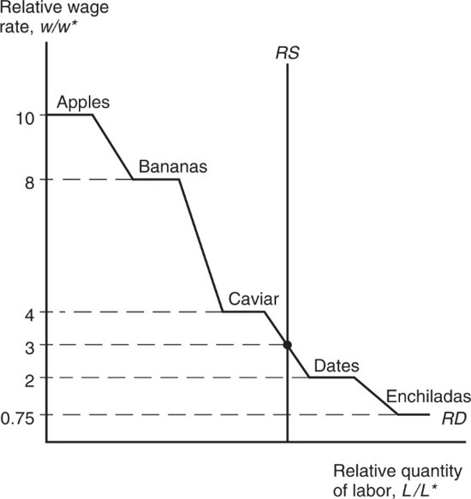
Figure 3.5 Determination of Relative Wages
In a many-good Ricardian model, relative wages are determined by the intersection of the derived relative demand curve for labor, R D, with the relative supply, R S.
Notes:
The relative demand for labor is a descending, stair stepped plot beginning at (0, 10), for apples. The plot decreases with varying steepness between other horizontal portions for types of fruit, at y = 8, bananas; y = 4, caviar; y = 2, dates; and y = 0.75, enchiladas. R S is a vertical line that intersects a sloping section between caviar and dates at y = 3.

Slide 73
Comparative Advantage with Many Goods (7 of 7)
Finally, suppose that relative supply of labor is
independent of
and is fixed at an amount
determined by the populations in the home and foreign countries.

Slide 74
Transportation Costs and Nontraded Goods (1 of 2)
The Ricardian model predicts that countries completely specialize in production.
But this rarely happens for three main reasons:
More than one factor of production reduces the tendency of specialization (Econ/Trade Chapters 4–5).
Protectionism (Econ/Trade Chapters 9–12).
Transportation costs reduce or prevent trade, which may cause each country to produce the same good or service.

Slide 75
Transportation Costs and Nontraded Goods (2 of 2)
Nontraded goods and services (e.g., haircuts and auto repairs) exist due to high transport costs.
Countries tend to spend a large fraction of national income on nontraded goods and services.
This fact has implications for the gravity model and for models that consider how income transfers across countries affect trade.

Slide 76
Empirical Evidence (1 of 3)
Do countries export those goods in which their productivity is relatively high?
The ratio of U.S. to British exports in 1951 compared to the ratio of U.S. to British labor productivity in 26 manufacturing industries suggests yes.
At this time, the United States had an absolute advantage in all 26 industries, yet the ratio of exports was low in the least productive sectors of the United States.

Slide 77
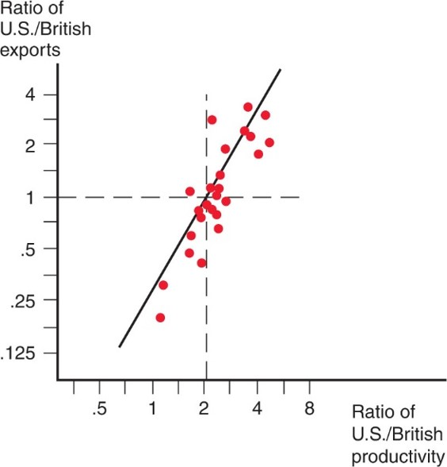
Figure 3.6 Productivity and Exports
A comparative study showed that U.S. exports were high relative to British exports in industries in which the United States had high relative labor productivity. Each dot represents a different industry.
Notes:
The data forms a pattern closely following a steeply rising line that extends from (0.7, 0.130) through (1, 2) and (6, 5). Most data points are clustered at the intersection of a dashed horizontal line, y = 1, and dashed vertical line, x = 2, and the rising line at point (2, 1).

Slide 78
Empirical Evidence (2 of 3)
A very poor country like Bangladesh can have comparative advantage in clothing despite being less productive in clothing than other countries such as China because it is even less productive compared to China in other sectors.
Productivity (output per worker) in Bangladesh is only 28 percent of China’s on average.
In apparel, productivity in Bangladesh was about 77 percent of China’s, creating strong comparative advantage in apparel for Bangladesh.

Slide 79
Table 3.3 Bangladesh Versus China, 2011
Blank | Bangladeshi Output per Worker as % of China | Bangladeshi exports as % of China
All industries | 28.5 | 1.0
Apparel | 77 | 15.5
Source: McKinsey and Company, “Bangladesh’s ready-made garments industry: The challenge of growth,” 2012; U N Monthly Bulletin of Statistics.

Slide 80
Empirical Evidence (3 of 3)
The main implications of the Ricardian model are well supported by empirical evidence:
productivity differences play an important role in international trade
comparative advantage (not absolute advantage) matters for trade

Slide 81
Summary (1 of 2)
Differences in the productivity of labor across countries generate comparative advantage.
A country has a comparative advantage in producing a good when its opportunity cost of producing that good is lower than other countries.
Countries export goods in which they have a comparative advantage—high productivity or low wages give countries a cost advantage.

Slide 82
Summary (2 of 2)
With trade, the relative price settles in between what the relative prices were in each country before trade.
Trade benefits all countries due to the relative price of the exported good rising: income for workers who produce exports rises, and imported goods become less expensive.
Empirical evidence supports trade based on comparative advantage, although transportation costs and other factors prevent complete specialization in production.

Slide 83

Copyright
This work is protected by United States copyright laws and is provided solely for the use of instructors in teaching their courses and assessing student learning. Dissemination or sale of any part of this work (including on the World Wide Web) will destroy the integrity of the work and is not permitted. The work and materials from it should never be made available to students except by instructors using the accompanying text in their classes. All recipients of this work are expected to abide by these restrictions and to honor the intended pedagogical purposes and the needs of other instructors who rely on these materials.

